Slide 1
Leadership Inferiority Feelings:
Measuring the Law of Movement in Organizations
David L. Hanson, Ph.D.
NASAP 2017 - 65th Annual Conference
Vancouver, BC, Canada
May 18-21, 2017
Copyright (C) 2017 David L. Hanson, Ph.D. SPA, PA All Rights Reserved [LifePsych.com]

Slide 2
Learning Objectives:
Participants will learn:
1. The “Law of Movement” as it relates to leadership inferiority feelings.
2. Assessment questions to be asked when assessing leadership behavior relative to striving for “Service Beyond Self” or “Self Above Service.”
3. How to document behavioral change plans and action steps to observe the “Law of Movement” activity over time.
Copyright (C) 2017 David L. Hanson, Ph.D. SPA, PA All Rights Reserved [LifePsych.com]

Slide 3
Presentation Organization
Self assessment
Derive the matrix
Apply the matrix
Two-points-of-a-line
Questions / Comments
Copyright (C) 2017 David L. Hanson, Ph.D. SPA, PA All Rights Reserved [LifePsych.com]

Slide 4
When conducting an initial interview with a CEO or other leader,
do not start with . . .
“First, let’s discuss your inferiority feelings.”
Copyright (C) 2017 David L. Hanson, Ph.D. SPA, PA All Rights Reserved [LifePsych.com]

Slide 5
LifePsych® Assessment
Write down
sources of your
“good” success.
(Handout)
Copyright (C) 2017 David L. Hanson, Ph.D. SPA, PA All Rights Reserved [LifePsych.com]

Slide 6
Life Tasks “Derived”
(Harold Mosak
at Davidson College)
Occupational (Basic needs)
Social (Socially embedded)
Sexual (Two sexes)

Slide 7
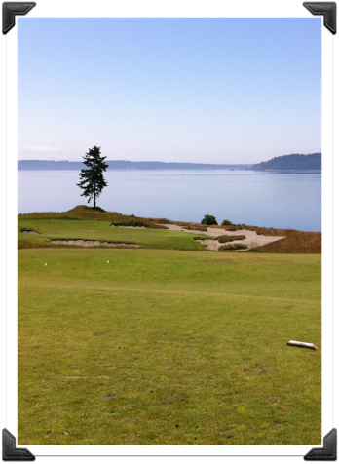
Mosak and Dreikurs
two additional
“Life Tasks”
Occupational
Social
Sexual
Defining oneself (harmony with “self”)
Meaning in life (harmony with the universe)

Slide 8
Inspired by
Dr. Hal McAbee
“Misguided Goals and Beyond”
Fall 1990

Slide 9
Matrix Model
Beginning with four
“Situational Realities”

Slide 10
An annotated explanation of each matrix cell can be found at:
http://www.gemalead360.com/four_situational_realities_matrix.html

Slide 11
What is our “situation”?
Where do we live?

Slide 12
We live on a ball of mud

Slide 13
“Evolutionary psychologists argue that much of human behavior is the output of
psychological adaptations
that evolved to solve recurrent problems in human ancestral environments.”
–Wikipedia

Slide 14
“Man's soul cannot act as a free agent because the necessity of solving the problems which constantly arise, determines the line of its activity.”
Alfred Adler, Understanding Human Nature

Slide 15
“Every voluntary act begins with a feeling of inadequacy,whose resolution proceeds toward a condition of satisfaction.”
–Alfred Adler, Understanding Human Nature

Slide 16
Substance Abuse
“H.A.L.T”
Hungry
Angry (via hurt)
Lonely
Tired

Slide 17
“The process of psychic life, the disquiet that seeks for compensations, that demands security and totality, begins as soon as the feeling of inferiority appears, for the purpose of securing peace and happiness in life.”
–Alfred Adler, Understanding Human Nature

Slide 18
“It is better to have the desire to be useful than the desire for self-elevation . . .”
–Rudolf Dreikurs, MD

Slide 19
Four Situational Realities Matrix
Existential Realities | Experiential Feelings | Compensatory Responses | Self Interest Goal (Task) | Social Interest Goal (Task)
Born on planet in motion | Movement | Activity | Chaos (Individualism) | Stability (Community)
Born with needs not provided | Anxiety | Work | Self-elevation (Entitlement) | Usefulness (Contribution)
Born as unitary individuals | Separateness | Relations | Control (Domination) | Belonging (Cooperation)
Born as helpless infants | Inferiority | Self | Vanity (Withdrawal) | Significance (Connection)
Discouraged
Impotency
Encouraged
Potency

Slide 20
“Potency thus is the same as virtue; impotence, the same as vice. Happiness is not an end in itself but is what accompanies the experience of increase in potency, while impotence is accompanied by depression”
Erich Fromm
Man for Himself: An inquiry into the psychology of ethics

Slide 21
“Psychology will be based on a new foundation, that of the necessary acquirement of each mental power and capacity by gradation.
–—Charles Darwin, The Origin of Species, 1859

Slide 22
Bill Gates:
“The most inspiring book I’ve ever read.”
The Better Angels of our Nature: Why Violence Has Declined
by Steven Pinker
(Hint: the world is getting better.)
Copyright (C) 2017 David L. Hanson, Ph.D. SPA, PA All Rights Reserved [LifePsych.com]

Slide 23
“Darwin long ago drew attention to the fact that one never found weak animals living alone; we are forced to consider man among these weak animals, because he likewise is not strong enough to live alone. He can offer only little resistance to nature.”
–Alfred Adler, Understanding Human Nature

Slide 24
Four Situational Realities Matrix
Existential Realities | Experiential Feelings | Compensatory Responses | Self Interest Goal (Task) | Social Interest Goal (Task)
Born on planet in motion | Movement | Activity | Chaos (Individualism) | Stability (Community)
Born with needs not provided | Anxiety | Work | Self-elevation (Entitlement) | Usefulness (Contribution)
Born as unitary individuals | Separateness | Relations | Control (Domination) | Belonging (Cooperation)
Born as helpless infants | Inferiority | Self | Vanity (Withdrawal) | Significance (Connection)
Discouraged
Impotency
Encouraged
Potency

Slide 25
Four Situational Realities Matrix
 |  |  | Self Interest Task | Social Interest Task
 |  |  | Individualism | Community
 |  | Work | Entitlement | Contribution
 |  | Relations | Domination | Cooperation
 |  | Self | Withdrawal | Connection

Slide 26
LifePsych® Assessment
Review
sources of your
“good” success.
(Review your results)
Copyright (C) 2017 David L. Hanson, Ph.D. SPA, PA All Rights Reserved [LifePsych.com]

Slide 28
“In all these cases, with their millions of variations a uniform kind of activity can always be observed. As a rule, one will be able to perceive the degree of activity also from the extent of the sphere of activity, which is different for each individual. It would be a tempting task for a psychologist to show graphically the extent and form of the individual life space.”
-Alfred Adler, Superiority and Social Interest

Slide 29
“Zoo Space”
Fish | Mammals
Amphibians | Reptiles
Invertebrates | Birds

Slide 30
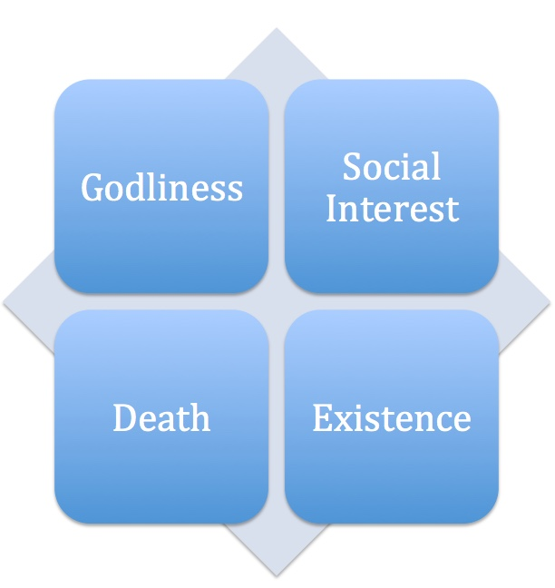
Individual Life Space
Copyright (C) 2017 David L. Hanson, Ph.D. SPA, PA All Rights Reserved [LifePsych.com]

Slide 31
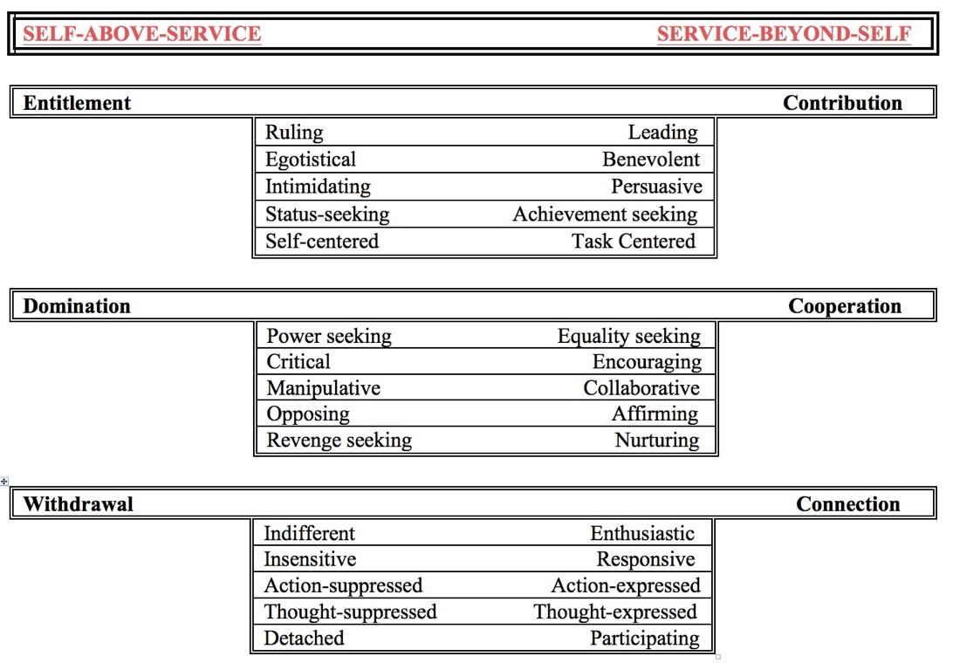

Slide 32
GEMA™-Lead360
(Goal Evaluation and Matrix Analysis)
www.gemalead360.com
Copyright (C) 2017 David L. Hanson, Ph.D. SPA, PA All Rights Reserved [LifePsych.com]

Slide 38
http:/www.gemalead360.com/example.html
Copyright (C) 2017 David L. Hanson, Ph.D. SPA, PA All Rights Reserved [LifePsych.com]

Slide 39
GEMA™-Lead360
(Goal Evaluation and Matrix Analysis)
FREE
Copyright (C) 2017 David L. Hanson, Ph.D. SPA, PA All Rights Reserved [LifePsych.com]

Slide 40
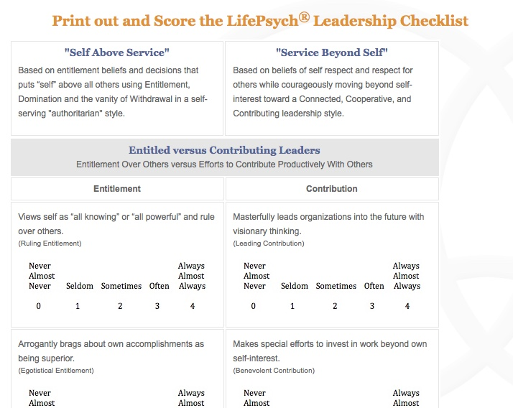
http:/www.gemalead360.com/LeadershipChecklist.html
Copyright (C) 2017 David L. Hanson, Ph.D. SPA, PA All Rights Reserved [LifePsych.com]

Slide 41
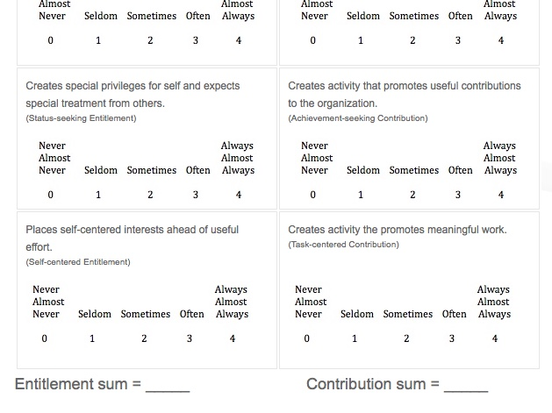
http://www.gemalead360.com/LeadershipChecklist.html
Copyright (C) 2017 David L. Hanson, Ph.D. SPA, PA All Rights Reserved [LifePsych.com]

Slide 42
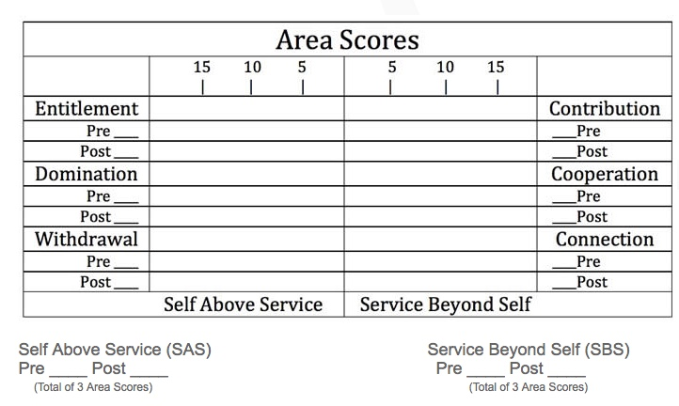
http://www.gemalead360.com/LeadershipChecklist.html
Copyright (C) 2017 David L. Hanson, Ph.D. SPA, PA All Rights Reserved [LifePsych.com]

Slide 43
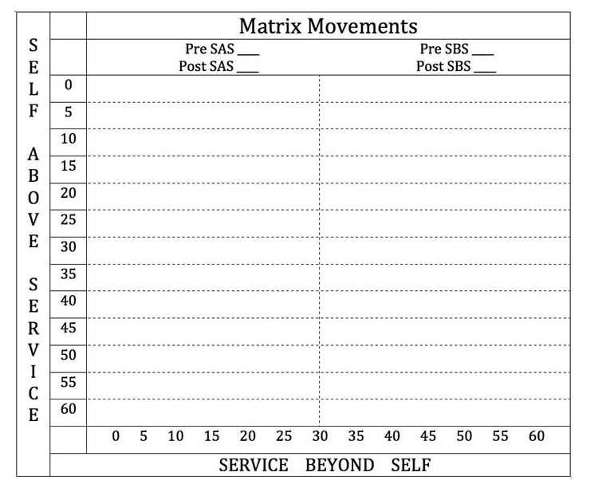
http://www.gemalead360.com/LeadershipChecklist.html
Copyright (C) 2017 David L. Hanson, Ph.D. SPA, PA All Rights Reserved [LifePsych.com]

Slide 44
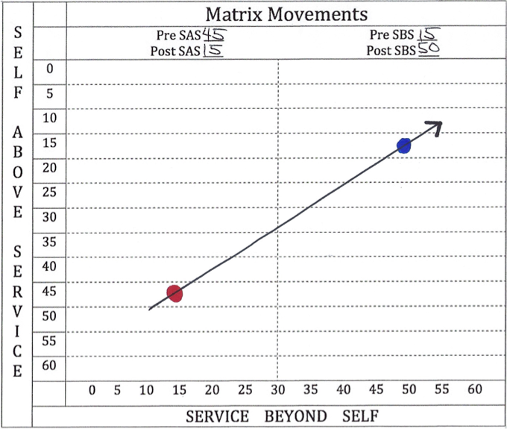
Copyright (C) 2017 David L. Hanson, Ph.D. SPA, PA All Rights Reserved [LifePsych.com]

Slide 45
“The great thing in this world is not so much where we are, but in which direction we are going.”
–Oliver Wendell Holmes

Slide 46
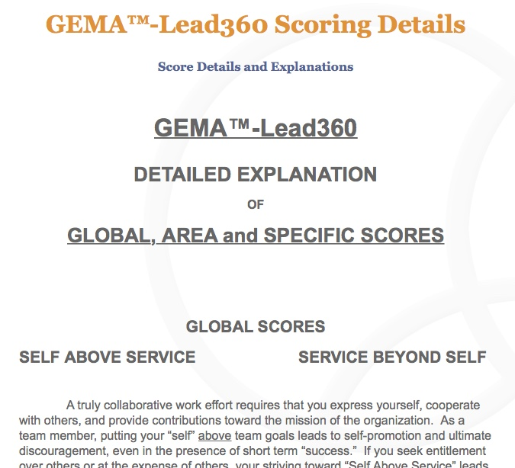

Slide 47
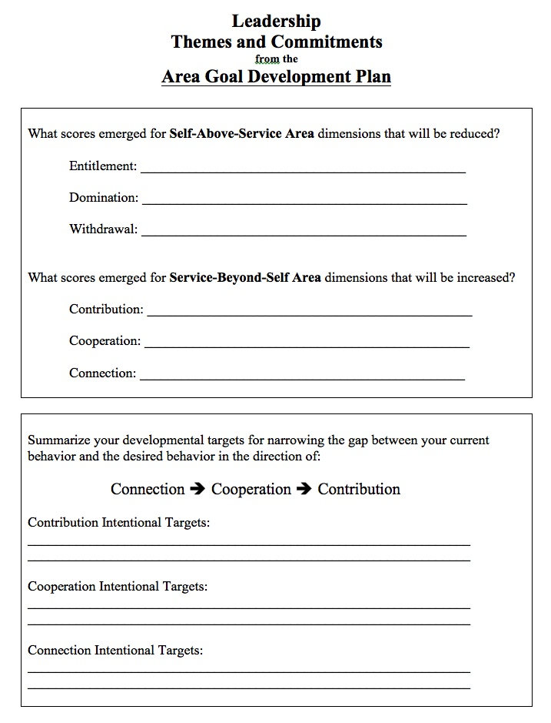
http://www.gemalead360.com/LeadershipChecklist.html
Copyright (C) 2017 David L. Hanson, Ph.D. SPA, PA All Rights Reserved [LifePsych.com]

Slide 48
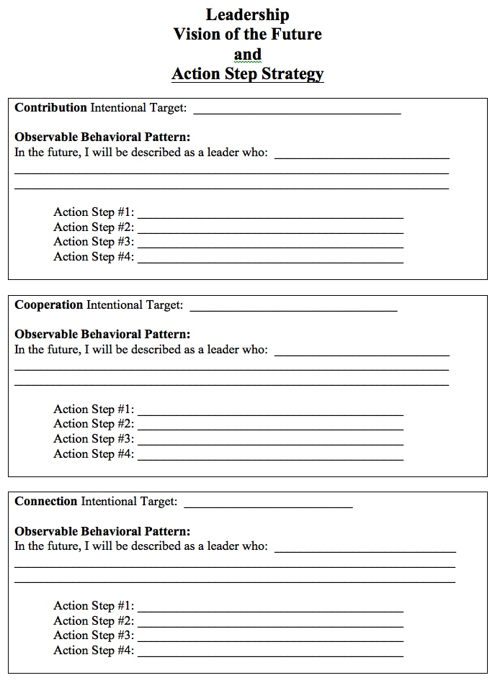
http://www.gemalead360.com/LeadershipChecklist.html
Copyright (C) 2017 David L. Hanson, Ph.D. SPA, PA All Rights Reserved [LifePsych.com]

Slide 49
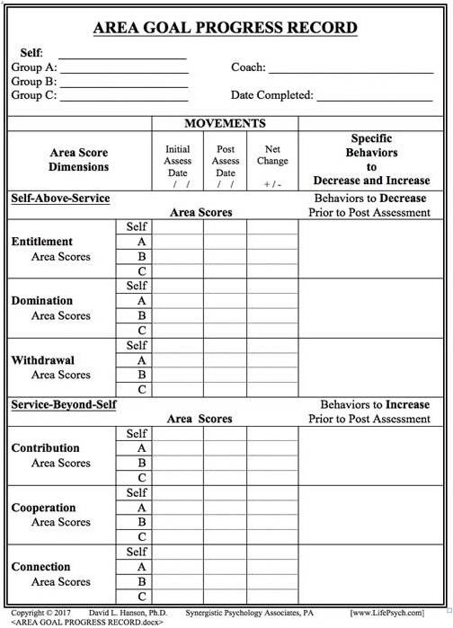
http://www.gemalead360.com/LeadershipChecklist.html
Copyright (C) 2017 David L. Hanson, Ph.D. SPA, PA All Rights Reserved [LifePsych.com]

Slide 51
Imagine
Knowing that each member of your team is making an effort, everyday, to be more:
Connected, Cooperative and Contributing

Slide 52
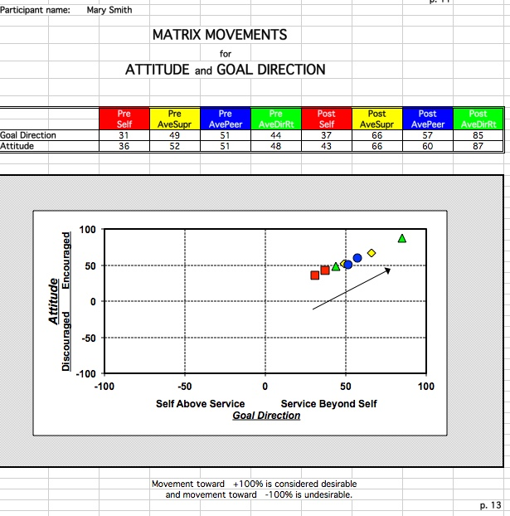
Copyright (C) 2017 David L. Hanson, Ph.D. SPA, PA All Rights Reserved [LifePsych.com]

Slide 53
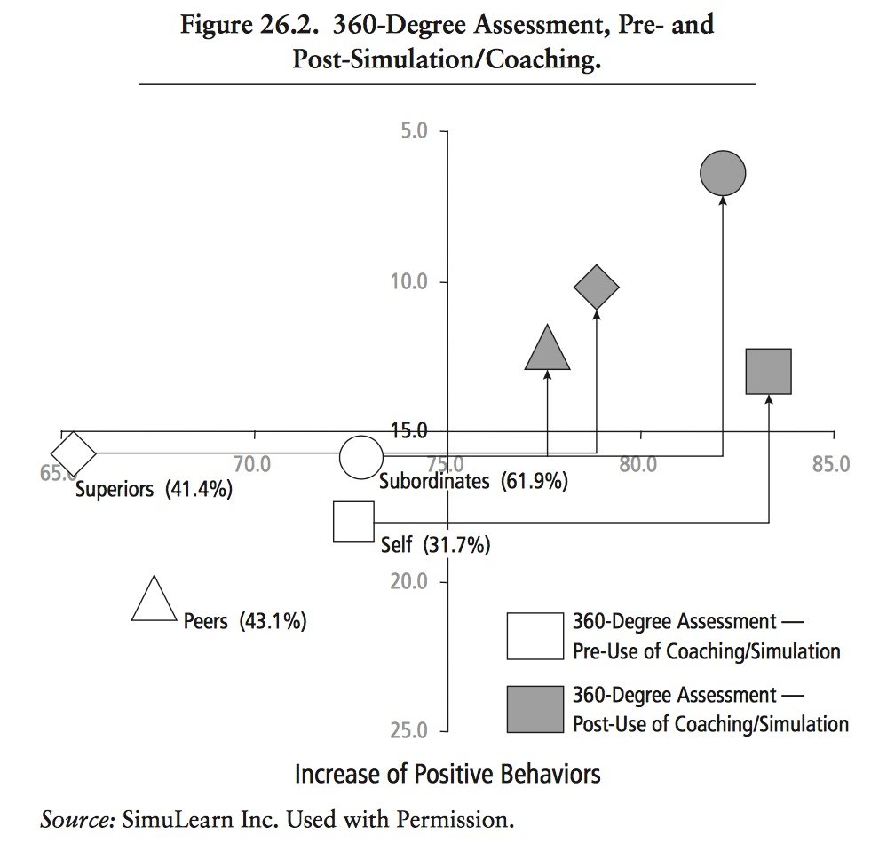
http://www.simulearn.net/download/Case_Study_Fortune_100.pdf
http://www.gemalead360.com/caseStudy.html
Copyright (C) 2017 David L. Hanson, Ph.D. SPA, PA All Rights Reserved [LifePsych.com]

Slide 54
“If we can succeed, however, in gaining a number of points where we can apply the leverage of our system, and join these into a single pattern, we have a system before us whose lines of force are evident, whose clear unit evaluation of the human being will be worth while.”
Alfred Adler, Understanding Human Nature

Slide 55
“Movement is meant to include all thought, feeling and physical activity; the law of movement of the individual is therefore the basis of the style of living. Movement connotes the understanding of human being as always in process, moving away from the felt minus toward a subjectively-conceived fictional plus position. . .”
-Adopted from Adlerpedia.org

Slide 58
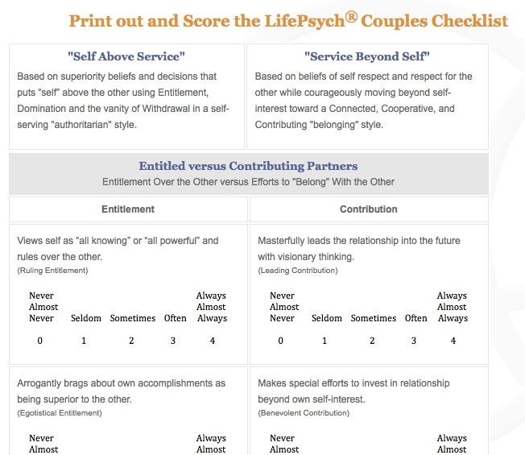
http://www.gemalead360.com/CouplesChecklist.html
Copyright (C) 2017 David L. Hanson, Ph.D. SPA, PA All Rights Reserved [LifePsych.com]

Slide 60
Seven
360s and Checklists
Copyright (C) 2017 David L. Hanson, Ph.D. SPA, PA All Rights Reserved [LifePsych.com]

Slide 61
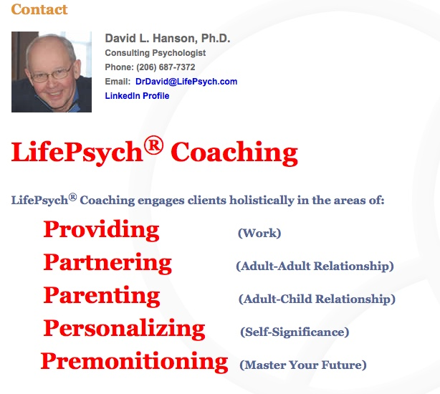

Slide 62
Just for fun . . .
Are you suited for the Great Northwest?
http://www.gemalead360.com/nwassess.html
Adlerian “Style-of-Life” Meditation
http://www.gemalead360.com/AdlerianMeditation.html
Copyright (C) 2017 David L. Hanson, Ph.D. SPA, PA All Rights Reserved [LifePsych.com]

Slide 63
Contacts
LifePsych.com
GEMALead360.com
LinkedIN: Linkedin.com/in/DavidLHansonPhD)
Business cell: 206-390-2867
Email: DrDavid@LifePsych.com

Slide 64
Q and A

Slide 65
Synergistic Psychology Associates, PA
David L. Hanson, Ph.D.
www.LinkedIn/com/in/DavidLHansonPhD
206-390-2867

Slide 66
Professional Growth Process
and
LifePsych® Coaching
Foundations for Intentional Innovation
www.LifePsych.com
Copyright (C) 2017 David L. Hanson, Ph.D. SPA, PA All Rights Reserved [LifePsych.com]

Slide 69
Professional Growth Process

Slide 70
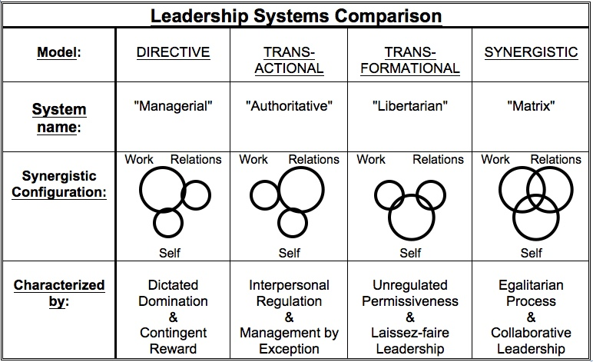

Slide 72
“Individual Psychology, therefore, creates for itself a heuristic system and method: to regard human behavior and understand it as though a final constellation of relationships were produced under the influence of the striving for a definite goal upon the basic inherited potentialities of the organism.”
–Alfred Adler, Understanding Human Nature, 1927

Slide 73
“As soon as the striving for recognition assumes the upper hand, it evokes a condition of greater tension in the psychic life. As a consequence, the goal of power and superiority becomes increasingly obvious to the individual, who pursues it with movements of great intensity and violence, and his life becomes the expectation of a great triumph. Such an individual loses his sense of reality because he loses his connection with life, being always occupied with the question of what other people think about him, and being concerned chiefly with the impression that he makes. The freedom of his action is inhibited to an extraordinary degree through this style of life, and his most obvious character trait becomes vanity. ”
–Alred Adler, Understanding Human Nature, 1927

Slide 74
Although not often conceptualized this way, the author believes that much of Adlerian Psychology is rooted in the writings and the philosophy of the great David Hume (1711-1776), credited by Kant as having created the Copernican revolution from the philosophy of Aristotle. For example, Hume suggested that a “mixed kind of life” was well suited for humans as he observed that humans are 1) rational [work] beings, 2) social beings, and 3) active beings. It is not an unreasonable stretch to conceptualize this in the form of work, relationships, and self, which is the basis for synergistic psychology.
–David L. Hanson, Ph.D.

Slide 76
References and Quotes
Adler, Alfred, Understanding Human Nature, translation by Colin Brett, 1927.
Ansbacher, H. & Ansbacher, R. (Eds.) Alfred Adler: Superiority and Social Interest: a collection of later writings, Northwestern University Press, 1964
Ansbacher, H. & Ansbacher, R. (Eds.) The Individual Psychology of Alfred Adler: a systematic presentation in selections from his writings. New York: Basic Books, 1956.
Ansbacher, H. & Ansbacher, R. (Eds.) Alfred Adler: Co-operation Between the Sexes: Writings on women and men, love and marriage, and sexuality, Norton & Company, 1978.
Kanter, J.W., et al, What is behavioral activation?: A review of the empirical literature. Clinical Psychology Review, 30(6), 608-620.
Manaster, G. “Social Interest, the individual, and society: Practical and theoretical considerations.” Journal of Individual Psychology, 59(2), 109-123.
Mosak, H.H. “Lifestyle.” In A.G. Nikelly, (Ed.) Techniques for Behavioral Change. 1971, 77-84.
Preiss, A. & Molina-Ray, C. “Leadership for Managers: An Adlerian Approach, Journal of Leadership Studies, 1(1), 2007
Shulman, B.H. & Dreikurs, S.G. “The contributions of Rudolph Dreikurs to the theory and practice of Individual Psychology.” Journal of Individual Psychology. 1978, 34(2), 153-169.

Slide 77
“For Adler, democracy is not a political system but a prescription for human interactions.”
Amy Preiss and Caroline Molina-Ray, 2007
Copyright (C) 2017 David L. Hanson, Ph.D. SPA, PA All Rights Reserved [LifePsych.com]

Slide 78
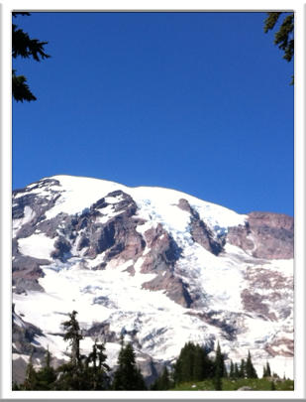
Individuals are highly capable of changing unproductive behavioral patterns and creating visions that challenge self-limiting assumptions. A systematic approach to development will create accelerated movement toward career aspirations.
“Adlerian psychology has been ‘rediscovered’ as a useful conceptual framework.”
-Manaster, 2003

Slide 79
“Although we cannot express this cosmic interpretation and this goal in a definite and exact term, we can nevertheless describe it as an ever-present aura, and as always in contradistinction to the feeling of inadequacy.”
Alfred Adler, Understanding human Nature

Slide 80
“. . . it is frequently convenient to show relationships between the childhood impressions and the actual complaint, as represented by the patient; this is best done by a graph, similar to a mathematical formula. A line connecting two points represents such an equation.”
Alfred Adler, Understanding Human Nature

